Slide 1
BASIC NETWORK PROGRAMMING
MODULE 1
INPUT / OUTPUT STREAM

Slide 2
Goals
become familiar with the concept of an I/O stream
understand the difference between binary files and text files
learn how to save data in a file
learn how to read data from a file
Understand the File/Data Format

Slide 3
Outline
Stream concepts
Input Streams
Output Streams
Reader
Writer
Object Serialization
Object Input Stream
Object Output Stream

Slide 4
STREAM CONCEPTS
MODULE 1
INPUT / OUTPUT STREAM

Slide 5
Stream concepts
File
information
Program
Memory
Network
Program
Data exchange
Data exchange type: Character, Object, voice, picture, audio, video...

Slide 6
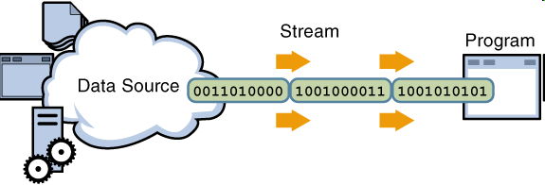
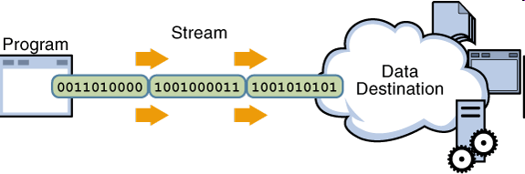
Stream concepts
An I/O Stream represents an input source or an output destination. A stream can represent many different kinds of sources and destinations, including disk files, devices, other programs, and memory arrays.
Streams support many different kinds of data, including simple bytes, primitive data types, localized characters, and objects. Some streams simply pass on data, others manipulate and transform the data in useful ways.
Reading information into a program
Writing information from a program

Slide 7
Stream concepts
Byte-level communication is represented in Java by data streams, which are conduits through which information—bytes of data—is sent and received
When designing a system, the correct stream must be selected
Streams may be chained together, to provide an easier and more manageable interface.
0110011
0110011
0110011
a

Slide 8
Stream concepts
Stream: an object that either delivers data to its destination (screen, file, etc.) or that takes data from a source (keyboard, file, etc.)
it acts as a buffer between the data source and destination
Input stream: a stream that provides input to a program
System.in is an input stream
Output stream: a stream that accepts output from a program
System.out is an output stream
A stream connects a program to an I/O object
System.out connects a program to the screen
System.in connects a program to the keyboard

Slide 9
Stream concepts
Basic Stream Operation:
open stream
close stream
read
write
Seek
Basic Stream Classification:
Input stream: support reading functions
Output stream: support writing functions
Filter stream: A filter stream is constructed on another stream (the underlying stream). Some streams buffer the data, some count data as it goes by, and others convert data to another form

Slide 10
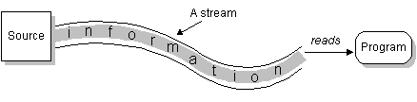
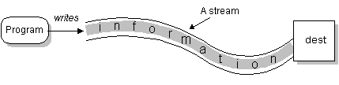
Input & Output Stream
Reading information into a program
Writing information out of a program

Slide 11
Reading and Writing Algorithm for Data
open input stream
while (more information){
read information
process information
}
close input stream
Reading from IS
open output stream
while (more information){
get information from ...
write information
}
close output stream
Writing into OS

Slide 12
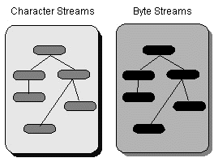
java.io package
The java.io package contains a collection of stream classes that support these algorithms for reading and writing. The stream classes are divided into two class hierarchies, based on the data type (either characters or bytes) on which they operate :
Byte Streams : input/output stream
Character Streams: reader/writer (unicode)

Slide 13
Binary Versus Text Files
All data and programs are ultimately just zeros and ones
each digit can have one of two values, hence binary
bit is one binary digit
byte is a group of eight bits
Text files: the bits represent printable characters
one byte per character for ASCII, the most common code
for example, Java source files are text files
so is any file created with a "text editor"
Binary files: the bits represent other types of encoded information, such as executable instructions or numeric data
these files are easily read by the computer but not humans
they are not "printable" files
actually, you can print them, but they will be unintelligible
"printable" means "easily readable by humans when printed"

Slide 14
Text Versus Binary Files
Text files are more readable by humans
Binary files are more efficient
computers read and write binary files more easily than text
Java binary files are portable
they can be used by Java on different machines
Reading and writing binary files is normally done by a program
text files are used only to communicate with humans
Java Text Files
Source files
Occasionally input files
Occasionally output files
Java Binary Files
Executable files (created by compiling source files)
Usually input files
Usually output files

Slide 15
Byte stream: input/output stream
Programs use byte streams to perform input and output of 8-bit bytes. All byte stream classes are descended from InputStream and OutputStream (Abstract class)
InputStream and OutputStream provide the API and partial implementation for input streams (streams that read 8-bit bytes) and output streams (streams that write 8-bit bytes).
These streams are typically used to read and write binary data such as images and sounds.

Slide 16
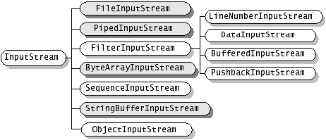
Input stream

Slide 17
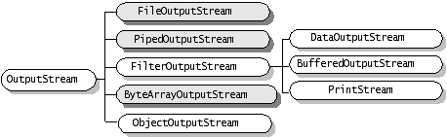
Output stream

Slide 18
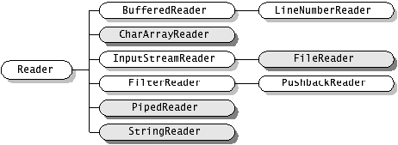
Character stream: reader/writer
The Java platform stores character values using Unicode conventions. Character stream I/O automatically translates this internal format to and from the local character set.
A program that uses character streams in place of byte streams automatically adapts to the local character set, and is ready for internationalization — all without extra effort by the programmer

Slide 19
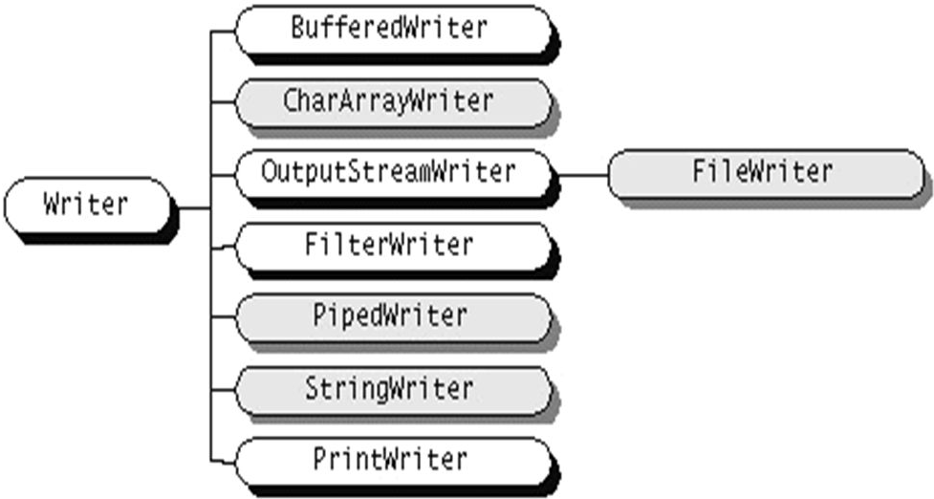
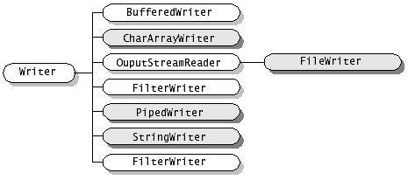
Writer

Slide 20
Stream overview
I/O | Streams | Mô tả khái quát
Memory | CharArrayReader CharArrayWriter ByteArrayInput- Stream ByteArrayOutput-Stream | Đọc/ghi từ/vào bộ nhớ. Tạo stream từ một mảng, tiếp theo dùng các phương thức đọc/ghi để đọc/ghi từ/vào mảng. Tác vụ đọc sẽ lấy dữ liệu từ mảng Tác vụ ghi sẽ ghi ra mảng
 | StringReader StringWriter StringBuffer- InputStream | StringReader để đọc các ký tự từ một String trong bộ nhớ. StringWriter để ghi vào String. StringBufferInputStream tương tự như StringReader. Sự khác biệt chỉ là StringBufferInputStream đọc các bytes từ một đối tượng StringBuffer

Slide 21
Stream overview
Pipe | PipedReader PipedWriter PipedInputStream PipedOutputStream | Hiện thực các thành phần input và output của một pipe. Pipes được dùng như một kênh truyền, nối output của một thread vào input của một thread khác.
File | FileReader FileWriter FileInputStream FileOutputStream | Được gọi là các file streams. File streams dùng để đọc/ghi từ/vào file trên file system.
Nối | SequenceInput- Stream (concatenation) | Nối nhiều input streams thành một input stream.

Slide 22
Stream overview
Object Serial- ization | ObjectInputStream ObjectOutputStream | Dùng khi cần lưu trữ, khôi phục, hoặc truyền toàn bộ đối tượng.
Chuyển đổi dạng dữ liệu (Data Conver-sion) | DataInputStream DataOutputStream | Thuận tiện khi cần đọc/ghi các kiểu dữ liệu cơ bản (primitive data types) như int, double, ...
Counting | LineNumberReader LineNumberInput- Stream | Theo dõi số hàng trong khi đọc

Slide 23
Stream overview
Printing | PrintWriter PrintStream | Rất thuận tiện khi cần kết xuất, dễ đọc với người. System.out là một đối tượng thuộc lớp PrintStream.
Đệm (Buffer-ing) | BufferedReader BufferedWriter bufferedInput-Stream BufferedOutput-Stream | Đệm dữ liệu trong các thao tác đọc/ghi. Đệm dữ liệu cải thiện tốc độ đọc ghi vì giảm số lần truy xuất thiết bị.
Lọc dữ liệu (Filtering) | FilterReader FilterWriter FilterInputStream FilterOutputStream | Các lớp abstract này định nghĩa các giao tiếp cho các filter streams lọc dữ liệu trong khi đọc/ghi.

Slide 24
Stream overview
Chuyển đổi byte ⬄ ký tự (Converting between Bytes and Characters) | InputStreamReader OutputStreamWriter | Cặp reader/writer này là cầu nối giữa các byte streams và character streams. Một InputStreamReader đọc các bytes từ một InputStream và chuyển các bytes đó thành các ký tự. Một OutputStreamWriter chuyển các ký tự sang các bytes, và ghi các bytes đó vào một OutputStream. Quá trình chuyển đổi sẽ sử dụng bộ mã mặc định nếu không được chỉ định rõ. Gọi System.getProperty("file.encoding") để lấy về tên bộ mã mặc định.

Slide 25
Stream sumary
InputStream, OutputStream, Reader và Writer là các lớp abstract:
Các lớp input stream được mở rộng từ lớp InputStream
Các lớp reader được mở rộng từ lớp Reader
Các lớp output stream được mở rộng từ lớp OutputStream
Các lớp writer được mở rộng từ lớp Writer
2 lớp InputStream và Reader cung cấp những phương thức read tương đối giống nhau.
2 lớp OutputStream và Writer cung cấp những phương thức write tương đối giống nhau.

Slide 26
INPUT STREAMS
MODULE 1
INPUT / OUTPUT STREAM

Slide 27
InputSream
Low-Level Input Stream Purpose of Stream
ByteArrayInputStream Reads bytes of data from an memory array
FileInputStream Reads bytes of data from a file on the local file system
PipedInputStream Reads bytes of data from a thread pipe
StringBufferInputStream Reads bytes of data from a string
System.in Reads bytes of data from the user console

Slide 28
API: The java.io.InputStream Class
int available() throws java.io.IOException— returns the number of bytes currently available for reading.
void close() throws java.io.IOException— closes the input stream and frees any resources (such as file handles or file locks) associated with the input stream.
int read() throws java.io.IOException— returns the next byte of data from the stream. When the end of the stream is reached, a value of –1 is returned.
int read(byte[] byteArray) throws java.io.IOException— reads a sequence of bytes and places them in the specified byte array. This method returns the number of bytes successfully read, or –1 if the end of the stream has been reached.
int read(byte[] byteArray, int offset, int length) throws java.io.IOException, java.lang.IndexOutOfBoundsException— reads a sequence of bytes, placing them in the specified array at the specified offset, and for the specified length, if possible.

Slide 29
API: The java.io.InputStream Class
long skip(long amount) throws java.io.IOException reads, but ignores, the specified amount of bytes. These bytes are discarded, and the position of the input stream is updated. The skip method returns the number of bytes skipped over, which may be less than the requested amount.
The following code fragment reads 10 bytes from the InputStream in and stores them in the byte array input. However, if end of stream is detected, the loop is terminated early:
byte[] input = new byte[10];
for (int i = 0; i < input.length; i++) {
int b = in.read( );
if (b == -1) break;
input[i] = (byte) b;
}

Slide 30
API: The java.io.InputStream Class
For example, you may try to read 1 024 bytes from a network connection, when only 512 have actually arrived from the server. The rest are still in transit. They'll arrive eventually, but they aren't available now.
byte[] input = new byte[1024];
int bytesRead = in.read(input);
It attempts to read 1 024 bytes from the InputStream in into the array input. However, if only 512 bytes are available, then bytesRead will be set to 512. To guarantee that all the bytes you want are actually read, you must place the read in a loop that reads repeatedly until the array is filled.
int bytesRead = 0;
int bytesToRead = 1024;
byte[] input = new byte[bytesToRead];
while (bytesRead < bytesToRead) {
bytesRead += in.read(input, bytesRead, bytesToRead - bytesRead);
}

Slide 31
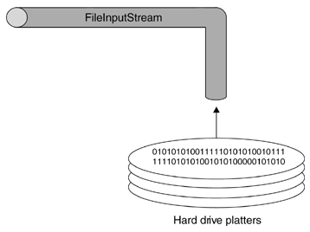
The java.io.FileInputStream Class
A FileInputStream obtains input bytes from a file in a file system. What files are available depends on the host environment.
FileInputStream is meant for reading streams of raw bytes such as image data. For reading streams of characters, consider using FileReader.

Slide 32
API: The java.io.FileInputStream Class
public FileInputStream(File file) throws FileNotFoundException
Creates a FileInputStream by opening a connection to an actual file, the file named by the File object file in the file system. A new FileDescriptor object is created to represent this file connection.
public FileInputStream(String name) throws FileNotFoundException
Creates a FileInputStream by opening a connection to an actual file, the file named by the path name name in the file system.
public int read() throws IOException
Reads a byte of data from this input stream. This method blocks if no input is yet available.
Returns: the next byte of data, or -1 if the end of the file is reached.

Slide 33
API: The java.io.FileInputStream Class
public int read(byte[] b) throws IOException
public int read(byte[] b, int off, int len)
Reads up to b.length bytes of data from this input stream into an array of bytes. This method blocks until some input is available.
Parameters:
b - the buffer into which the data is read.
off - the start offset of the data.
len - the maximum number of bytes read.
Returns: the total number of bytes read into the buffer, or -1 if there is no more data because the end of the file has been reached.

Slide 34
API: The java.io.FileInputStream Class
public long skip(long n) throws IOException
Skips over and discards n bytes of data from the input stream.
Parameters: n - the number of bytes to be skipped.
Returns: the actual number of bytes skipped.
Throws: IOException - if n is negative, or if an I/O error occurs.
public int available() throws IOException
Returns the number of bytes that can be read from this file input stream without blocking.
public void close() throws IOException
Closes this file input stream and releases any system resources associated with the stream.

Slide 35
A FileInputStream Demo
Below we examine a practical application of using a low-level input stream to display the contents of a file. A byte at a time is read from the file and displayed to the screen.
// Create an input stream, reading from the specified file InputStream fileInput = new FileInputStream (fName); // Read the first byte of data int data = fileInput.read(); // Repeat : until end of file (EOF) reached while (data != -1){
// Send byte to standard output
System.out.write ( data );
//System.out.flush();
// Read next byte
data = fileInput.read();
}

Slide 36
A FileInputStreamDemo
import java.io.*;
public class FileInputStreamDemo{
public static void main(String args[]){
if (args.length != 1){
System.err.println ("Syntax - FileInputStreamDemo file");
return;
}
try{
InputStream fileInput = new FileInputStream( args[0] );
int data = fileInput.read();
while (data != -1){
System.out.write ( data );
data = fileInput.read();
}
// System.out.flush();
fileInput.close();
}
catch (IOException ioe){
System.err.println ("I/O error - " + ioe);
}}}

Slide 37

OUTPUT STREAMS
MODULE 1
INPUT / OUTPUT STREAM

Slide 38
Ouput Streams
Low-Level Output Stream Purpose of Stream
ByteArrayOutputStream Writes bytes of data to an array of bytes.
FileOutputStream Writes bytes of data to a local file.
StringBufferOutputStream
Writes bytes to a string buffer (a substitute data structure for the fixed-length string).
System.err Writes bytes of data to the error stream of the user console, also known as standard error. In addition, this stream is cast to a PrintStream.
System.out Writes bytes of data to the user console, also known as standard output. In addition, this stream is cast to a PrintStream.

Slide 39
API: java.io.OutputStream Class
void close() throws java.io.IOException— closes the output stream, notifying the other side that the stream has ended. Pending data that has not yet been sent will be sent, but no more data will be delivered.
void flush() throws java.io.IOException— performs a "flush" of any unsent data and sends it to the recipient of the output stream. To improve performance, streams will often be buffered, so data remains unsent. The method is particularly important for OutputStream subclasses that represent network operations, as flushing should always occur after a request or response is sent so that the remote side isn't left waiting for data.

Slide 40
API: java.io.OutputStream Class
void write(int byte) throws java.io.IOException writes the specified byte. This is an abstract method, overridden by OutputStream subclasses.
void write(byte[] byteArray) throws java.io.IOException writes the contents of the byte array to the output stream. The entire contents of the array (barring any error) will be written.
void write(byte[] byteArray, int offset, int length) throws java.io.IOException writes the contents of a subset of the byte array to the output stream. This method allows developers to specify just how much of an array is sent, and which part, as opposed to the OutputStream.write(byte[] byteArray) method, which sends the entire contents of an array.

Slide 41
API: java.io.FileOutputStream
public FileOutputStream(String name) throws FileNotFoundException
Creates an output file stream to write to the file with the specified name.
Throws: FileNotFoundException - if the file exists but is a directory rather than a regular file, does not exist but cannot be created, or cannot be opened for any other reason
public FileOutputStream(String name, boolean append) throws FileNotFoundException
Creates an output file stream to write to the file with the specified name. If the second argument is true, then bytes will be written to the end of the file rather than the beginning.
If the file exists but is a directory rather than a regular file, does not exist but cannot be created, or cannot be opened for any other reason then a FileNotFoundException is thrown.

Slide 42
API: java.io.FileOutputStream
public FileOutputStream(File file) throws FileNotFoundException
Creates a file output stream to write to the file represented by the specified File object
public FileOutputStream(File file, boolean append) throws FileNotFoundException
public void write(int b) throws IOException
Writes the specified byte to this file output stream. Implements the write method of OutputStream.
public void write(byte[] b) throws IOException
Writes b.length bytes from the specified byte array to this file output stream.
public void write(byte[] b, int off, int len) throws IOException
Writes len bytes from the specified byte array starting at offset off to this file output stream.
public void close() throws IOException
Closes this file output stream and releases any system resources associated with this stream. This file output stream may no longer be used for writing bytes.

Slide 43
FileOutputStream Demo (FileCopy)
The program copies a file by reading the contents of the file and writing it, one byte at a time, to a new file.
To open a file for writing, a FileOutputStream is used. This class will create a file, if one does not already exist, or override the contents of the file (unless opened in append mode).
// Output file for output
OutputStream output = new FileOutputStream(destination);
Once opened, it can be written to by invoking the OutputStream.write() method. This method is called repeatedly by the application, to write the contents of a file that it is reading.
while ( data != -1){
// Write byte of data to our file
output.write (data);
// Read next byte
data=input.read();
}

Slide 44
FileOutputStream Demo (FileCopy)
import java.io.*;
public class FileOutputStreamDemo{
public static void main(String args[]){
// Two parameters are required, the source and destination
if (args.length != 2){
System.err.println("Syntax - FileOutputStreamDemo src dest");
return;
}
String source = args[0];
String destination = args[1];
try{
// Open source file for input
InputStream input = new FileInputStream( source );
System.out.println ("Opened " +source + " for reading.");
// Output file for output
OutputStream output = new FileOutputStream(destination);
System.out.println ("Opened " +destination + " for writing.");

Slide 45
FileOutputStream Demo (FileCopy)
int data = input.read();
while ( data != -1){
// Write byte of data to our file
output.write (data);
// Read next byte
data=input.read();
}
// Close both streams
input.close();
output.close();
System.out.println ("I/O streams closed");
}
catch (IOException ioe){
System.err.println ("I/O error - " + ioe);
}}}

Slide 46
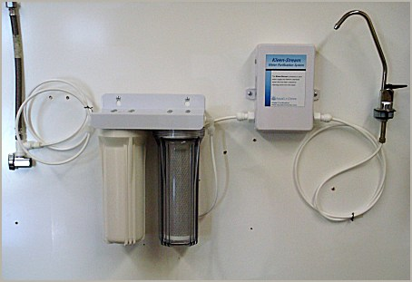
FILTER STREAMS
MODULE 1
INPUT / OUTPUT STREAM

Slide 47
Filter Streams
Filter streams add additional functionality to an existing stream, by processing data in some form (such as buffering for performance) or offering additional methods that allow data to be accessed in a different manner (for example, reading a line of text rather than a sequence of bytes).
Filters make life easier for programmers, as they can work with familiar constructs such as strings, lines of text, and numbers, rather than individual bytes.
Filter streams can be connected to any other stream, to a low-level stream or even another filter stream. Filter streams are extended from the java.io.FilterInputStream and java.io.FilterOutputStream classes.

Slide 48
Filter Streams
For example, suppose you wanted to connect a PrintStream (used to print text to an OutputStream subclass) to a stream that wrote to a file. The following code may be used to connect the filter stream and write a message using the new filter.
FileOutputStream fout = new FileOutputStream ( somefile ); PrintStream pout = new PrintStream (fout); pout.println ("hello world");
This process is fairly simple as long as the programmer remembers two things:
Read and write operations must take place on the new filter stream.
Read and write operations on the underlying stream can still take place, but not at the same time as an operation on the filter stream.

Slide 49
Filter Streams
Filter Input Stream Purpose of Stream
BufferedInputStream Buffers access to data, to improve efficiency.
DataInputStream Reads primitive data types, such as an int, a float, a double, or even a line of text, from an input stream.
BufferedOutputStream
DataOutputStream
PrintStream

Slide 50
BufferedInputStream
BufferedInputStream (InputStream input) creates a buffered stream that will read from the specified InputStream object.
BufferedInputStream (InputStream input, int bufferSize) throws java.lang.IllegalArgumentException— creates a buffered stream, of the specified size, which reads from the InputStream object passed as a parameter.
BufferedInputStream does not declare any new methods of its own. It only overrides methods from InputStream.
Chaining Filters Together
DataOutputStream dout = new DataOutputStream(
new BufferedOutputStream(
new FileOutputStream("data.txt")));
DataInputStream din = new DataInputStream(
new BufferedInputStream(
new FileInputStream("data.txt")));

Slide 51
FileCopy using BufferedInputStream
import java.io.*;
public class BufferCopyFile{
public static void copy(String sfile, String destfile) throws IOException{
int bufferSize = 10240;
BufferedInputStream fis = new BufferedInputStream(new FileInputStream(sfile),bufferSize);
BufferedOutputStream fos = new BufferedOutputStream(new FileOutputStream(destfile),bufferSize);
int c;
long beginTime = System.currentTimeMillis();
while((c=fis.read())>-1) fos.write(c);
long endTime = System.currentTimeMillis();
System.out.println("Copy time: "+(endTime-beginTime)+ "ms");
fis.close();
fos.close();
}

Slide 52
A Speed of new FileCopy
Example runs of the following BufferCopyFile, with text files of various sizes, shows gains of ~3x. (In Java Platform Performance by Wilson and Kesselman, an example using a 370K JPEG file has a gain in execution speed of 83x!)
Size - 624 bytes : With buffering: 10 ms Without buffering: 30 ms
Size - 10,610 bytes : With buffering: 30 ms Without buffering: 80 ms
Size - 742,702 bytes : With buffering: 180 ms Without buffering: 741 ms

Slide 53
DataInputStream Class
The DataInputStream and DataOutputStream classes provide methods for reading and writing Java's primitive data types and strings in a binary format. The binary formats used are primarily intended for exchanging data between two different Java programs whether through a network connection, a data file, a pipe, or some other intermediary. What a data output stream writes, a data input stream can read.
Constructors DataInputStream (InputStream in) creates a data input stream, reading from the specified input stream.

Slide 54
API: DataInputStream Class
public final int read(byte[] b) throws IOException
Reads some number of bytes from the contained input stream and stores them into the buffer array b. This method blocks until input data is available, end of file is detected, or an exception is thrown.
public final int read(byte[] b, int off, int len) throws IOException
Reads up to len bytes of data from the contained input stream into an array of bytes. This method blocks until input data is available, end of file is detected, or an exception is thrown.
public final int skipBytes(int n)
public final boolean readBoolean()
public final byte readByte() : signed 8-bit byte
public final int readUnsignedByte():an unsigned 8-bit number

Slide 55
API: DataInputStream Class
public final short readShort() : a signed 16-bit number
public final int readUnsignedShort() : an unsigned 16-bit integer
public final char readChar() : 2 bytes of this input stream as a Unicode character
public final int readInt() : 4 bytes of this input stream, interpreted as an int
public final long readLong() : 8 bytes of this input stream, interpreted as a long
public final float readFloat() : 4 bytes of this input stream, interpreted as a float.
public final double readDouble() : 8 bytes of this input stream, interpreted as a double

Slide 56
API: PrintStream Class
The PrintStream class is the first filter output stream most programmers encounter because System.out is a PrintStream. However, other output streams can also be chained to print streams, using these two constructors:
public PrintStream(OutputStream out) public PrintStream(OutputStream out, boolean autoFlush)
By default, print streams should be explicitly flushed. However, if the autoFlush argument is true, then the stream will be flushed every time a byte array or linefeed is written or a println( ) method is invoked.

Slide 57
API: PrintStream Class
void print(boolean value)— prints a boolean value.
void print(char character)— prints a character value.
void print(char[] charArray)— prints an array of characters.
void print(double doubleValue)— prints a double value.
void print(float floatValue)— prints a float value.
void print(int intValue)— prints an int value.
void print(long longValue)— prints a long value.
void print(Object obj)— prints the value of the specified object's toString() method.
void print(String string)— prints a string's contents.
void println()— sends a line separator (such as '\n'). This value is system dependent and determined by the value of the system property "line.separator."

Slide 58
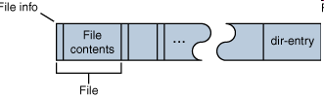
Random Access File Stream
Random access files permit nonsequential, or random, access to a file's contents.
Consider the archive format known as ZIP. A ZIP archive contains files and is typically compressed to save space. It also contain a directory entry at the end that indicates where the various files contained within the ZIP archive begin, as shown in the following figure.

Slide 59
Random Access File Stream
Suppose that you want to extract a specific file from a ZIP archive. If you use a sequential access stream, you have to:
Open the ZIP archive.
Search through the ZIP archive until you located the file you wanted to extract.
Extract the file.
Close the ZIP archive.
Using this procedure, on average, you'd have to read half the ZIP archive before finding the file that you wanted to extract. You can extract the same file from the ZIP archive more efficiently by using the seek feature of a random access file and following these steps:
Open the ZIP archive.
Seek to the directory entry and locate the entry for the file you want to extract from the ZIP archive.
Seek (backward) within the ZIP archive to the position of the file to extract.
Extract the file.
Close the ZIP archive.

Slide 60

Random Access File Stream
RandomAccessFile supports the notion of a file pointer. The file pointer indicates the current location in the file. When the file is first created, the file pointer is set to 0, indicating the beginning of the file.
In addition to the normal file I/O methods that implicitly move the file pointer when the operation occurs, RandomAccessFile contains three methods for explicitly manipulating the file pointer.
int skipBytes(int) — Moves the file pointer forward the specified number of bytes
void seek(long) — Positions the file pointer just before the specified byte
long getFilePointer() — Returns the current byte location of the file pointer

Slide 61
Random Access File Stream

Slide 62
Java.io.RandomAccessFile
A random access file behaves like a large array of bytes stored in the file system. There is a kind of cursor, or index into the implied array, called the file pointer; input operations read bytes starting at the file pointer and advance the file pointer past the bytes read
The file pointer can be read by the getFilePointer method and set by the seek method
public RandomAccessFile(String name, String mode) public RandomAccessFile(File file, String mode)
Creates a random access file stream to read from, and optionally to write to, a file with the specified name.
"r“ Open for reading only.
"rw“ Open for reading and writing. If the file does not already exist then an attempt will be made to create it.

Slide 63
Java.io.RandomAccessFile
public int read() throws IOException
Reads a byte of data from this file. The byte is returned as an integer in the range 0 to 255 (0x00-0x0ff). This method blocks if no input is yet available.
public int read(byte[] b, int off, int len) throws IOException
Reads up to len bytes of data from this file into an array of bytes. This method blocks until at least one byte of input is available.
public int read(byte[] b) throws IOException
Reads up to b.length bytes of data from this file into an array of bytes. This method blocks until at least one byte of input is available.
public long getFilePointer() throws IOException
Returns the current offset in this file.

Slide 64
Java.io.RandomAccessFile
public void write(int b) throws IOException
Writes the specified byte to this file. The write starts at the current file pointer.
public void write(byte[] b) throws IOException
Writes b.length bytes from the specified byte array to this file, starting at the current file pointer.
public void write(byte[] b, int off, int len) throws …
Writes len bytes from the specified byte array starting at offset off to this file
public void seek(long pos) throws IOException
Sets the file-pointer offset, measured from the beginning of this file, at which the next read or write occurs. The offset may be set beyond the end of the file. Setting the offset beyond the end of the file does not change the file length. The file length will change only by writing after the offset has been set beyond the end of the file.

Slide 65
Java.io.RandomAccessFile
public long length() throws IOException
Returns the length of this file.
public void setLength(long newLength) throws ….
Sets the length of this file. If the present length of the file is greater than the newLength argument then the file will be truncated. In this case, if the file offset as returned by the getFilePointer method is greater than newLength then after this method returns the offset will be equal to newLength.
If the present length of the file as returned by the length method is smaller than the newLength argument then the file will be extended. In this case, the contents of the extended portion of the file are not defined.
public void close() throws IOException
Closes this random access file stream and releases any system resources associated with the stream

Slide 66
Java.io.RandomAccessFile
public final boolean readBoolean()
public final byte readByte()
public final int readUnsignedByte()
public final short readShort()
public final int readUnsignedShort()
public final char readChar()
public final int readInt()
public final long readLong()
public final float readFloat()
public final double readDouble()
public final String readLine()
public final void writeBoolean(boolean v)
public final void writeByte(int v)
public final void writeShort(int v)

Slide 67
Java.io.RandomAccessFile
public final void writeChar(int v)
public final void writeInt(int v)
public final void writeLong(long v)
public final void writeFloat(float v)
public final void writeDouble(double v)
public final void writeBytes(String s) throws IOException
Writes the string to the file as a sequence of bytes. Each character in the string is written out, in sequence, by discarding its high eight bits. The write starts at the current position of the file pointer.
public final void writeChars(String s) throws IOException
Writes a string to the file as a sequence of characters. Each character is written to the data output stream as if by the writeChar method. The write starts at the current position of the file pointer.

Slide 68
New I/O
The Java “new” I/O library, introduced in JDK 1.4 in the java.nio.* packages, has one goal: speed.
The speed comes by using structures which are closer to the operating system’s way of performing I/O: channels and buffers.
Java NIO consist of the following core components:
Channels
Buffers
Selectors

Slide 69
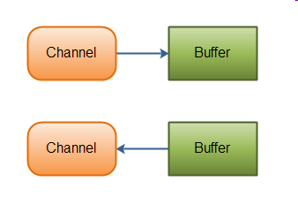
Channels and Buffers
Typically, all IO in NIO starts with a Channel. A Channel is a bit like a stream. From the Channel data can be read into a Buffer. Data can also be written from a Buffer into a Channel

Slide 70
Channels and Buffers
There are several Channel and Buffer types. Here is a list of the primary Channel implementations in Java NIO:
FileChannel
DatagramChannel
SocketChannel
ServerSocketChannel
Here is a list of the core Buffer implementations in Java NIO:
ByteBuffer
CharBuffer
DoubleBuffer
FloatBuffer
IntBuffer
LongBuffer
ShortBuffer

Slide 71
Channel
Java NIO Channels are similar to streams with a few differences:
You can both read and write to a Channels. Streams are typically one-way (read or write).
Channels can be read and written asynchronously.
Channels always read to, or write from, a Buffer.
RandomAccessFile aFile = new RandomAccessFile("data/nio-data.txt", "rw");
FileChannel inChannel = aFile.getChannel();
ByteBuffer buf = ByteBuffer.allocate(48);
int bytesRead = inChannel.read(buf);
while (bytesRead != -1) {
System.out.println("Read " + bytesRead);
buf.flip();
while(buf.hasRemaining()){
System.out.print((char) buf.get());
}
buf.clear();
bytesRead = inChannel.read(buf);
}
aFile.close();

Slide 72
Java NIO Buffer
A buffer is essentially a block of memory into which you can write data, which you can then later read again. This memory block is wrapped in a NIO Buffer object, which provides a set of methods that makes it easier to work with the memory block.
Here is a list of the topics covered for NIO Buffer's:
Basic Buffer Usage
Buffer Capacity, Position and Limit
Buffer Types
Allocating a Buffer
Writing Data to a Buffer
flip()
Reading Data from a Buffer
clear() and compact()
mark() and reset()
equals() and compareTo()

Slide 73
Basic Buffer Usage
Write data into the Buffer
Call buffer.flip()
Read data out of the Buffer
Call buffer.clear() or buffer.compact()
RandomAccessFile aFile = new RandomAccessFile("data/nio-data.txt", "rw");
FileChannel inChannel = aFile.getChannel();
//create buffer with capacity of 48 bytes
ByteBuffer buf = ByteBuffer.allocate(48);
int bytesRead = inChannel.read(buf); //read into buffer.
while (bytesRead != -1) {
buf.flip(); //make buffer ready for read
while(buf.hasRemaining()){
System.out.print((char) buf.get()); // read 1 byte at a time
}
buf.clear(); //make buffer ready for writing
bytesRead = inChannel.read(buf);
}
aFile.close();

Slide 74
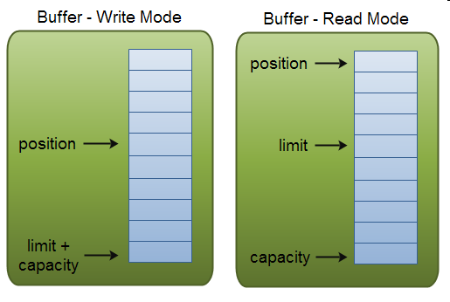
Buffer Capacity, Position and Limit
A buffer's capacity is the number of elements it contains. The capacity of a buffer is never negative and never changes.
A buffer's limit is the index of the first element that should not be read or written. A buffer's limit is never negative and is never greater than its capacity.
A buffer's position is the index of the next element to be read or written. A buffer's position is never negative and is never greater than its limit.

Slide 75
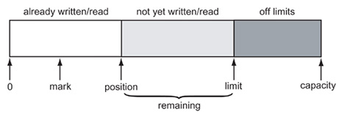
The Buffer Data Structure
A buffer is an array of values of the same type. The Buffer class is an abstract class with concrete subclasses ByteBuffer, CharBuffer, DoubleBuffer, FloatBuffer, IntBuffer, LongBuffer, and ShortBuffer. In practice, you will most commonly use ByteBuffer and CharBuffer. A Buffer has:
a capacity that never changes
a position at which the next value is read or written
a limit beyond which reading and writing is meaningless
optionally, a mark for repeating a read or write operation

Slide 76
java.nio.Buffer
public final int capacity()
Returns this buffer's capacity.
public final int position()
Returns this buffer's position.
public final Buffer position(int newPosition)
Sets this buffer's position. If the mark is defined and larger than the new position then it is discarded.
public final int limit()
Returns this buffer's limit.
public final Buffer limit(int newLimit)
Sets this buffer's limit. If the position is larger than the new limit then it is set to the new limit. If the mark is defined and larger than the new limit then it is discarded.

Slide 77
java.nio.Buffer
public final Buffer flip()
Flips this buffer. The limit is set to the current position and then the position is set to zero. If the mark is defined then it is discarded. After a sequence of channel-read or put operations, invoke this method to prepare for a sequence of channel-write or relative get operations. For example:
buf.put(magic); // Prepend header in.read(buf); // Read data into rest of buffer buf.flip(); // Flip buffer out.write(buf); // Write header + data to channel
public final Buffer rewind()
Rewinds this buffer. The position is set to zero and the mark is discarded. Invoke this method before a sequence of channel-write or get operations, assuming that the limit has already been set appropriately. For example:
out.write(buf); // Write remaining data buf.rewind(); // Rewind buffer buf.get(array); // Copy data into array

Slide 78
java.nio.Buffer
public final Buffer clear()
Clears this buffer. The position is set to zero, the limit is set to the capacity, and the mark is discarded. Invoke this method before using a sequence of channel-read or put operations to fill this buffer. For example:
buf.clear(); // Prepare buffer for reading in.read(buf); // Read data
public final int remaining()
Returns the number of elements between the current position and the limit.
public final boolean hasRemaining()
Tells whether there are any elements between the current position and the limit.

Slide 79
java.nio.channels.FileChannel
This class does not define methods for opening existing files or for creating new ones; such methods may be added in a future release. In this release a file channel can be obtained from an existing FileInputStream, FileOutputStream, or RandomAccessFile object by invoking that object's getChannel method, which returns a file channel that is connected to the same underlying file.
public abstract int read(ByteBuffer dst)
public abstract long read(ByteBuffer[] dsts, int offset, int length)
public abstract int write(ByteBuffer src)
public abstract long write(ByteBuffer[] srcs, int offset, int length)
public abstract long position()
public abstract FileChannel position(long newPosition)

Slide 80
java.nio.channels.FileChannel
public abstract long size() throws IOException
Returns the current size of this channel's file, measured in bytes
public abstract FileChannel truncate(long size) throws IOException
Truncates this channel's file to the given size. If the given size is less than the file's current size then the file is truncated, discarding any bytes beyond the new end of the file. If the given size is greater than or equal to the file's current size then the file is not modified. In either case, if this channel's file position is greater than the given size then it is set to that size.
public abstract void force(boolean metaData) throws IOException
Forces any updates to this channel's file to be written to the storage device that contains it.
public abstract long transferTo(long position, long count, WritableByteChannel target) throws IOException
Transfers bytes from this channel's file to the given writable byte channel.

Slide 81
java.nio.channels.FileChannel
public abstract long transferFrom(ReadableByteChannel src, long position, long count) throws IOException
Transfers bytes into this channel's file from the given readable byte channel.
public abstract int read(ByteBuffer dst, long position)
public abstract int write(ByteBuffer src, long position)
public abstract FileLock lock(long position, long size, boolean shared) throws IOException
public abstract FileLock tryLock(long position, long size, boolean shared) throws IOException
Acquires a lock on the given region of this channel's file.
position : The position at which the locked region is to start; must be non-negative
size : The size of the locked region; must be non-negative, and the sum position + size must be non-negative
shared : true to request a shared lock, in which case this channel must be open for reading (and possibly writing); false to request an exclusive lock, in which case this channel must be open for writing (and possibly reading)

Slide 82
java.nio.channels.FileChannel
public abstract MappedByteBuffer map(FileChannel.MapMode mode, long position, long size) throws IOException
Maps a region of this channel's file directly into memory. A region of a file may be mapped into memory in one of three modes:
Read-only: Any attempt to modify the resulting buffer will cause a ReadOnlyBufferException to be thrown. (MapMode.READ_ONLY)
Read/write: Changes made to the resulting buffer will eventually be propagated to the file; they may or may not be made visible to other programs that have mapped the same file. (MapMode.READ_WRITE)
Private: Changes made to the resulting buffer will not be propagated to the file and will not be visible to other programs that have mapped the same file; instead, they will cause private copies of the modified portions of the buffer to be created. (MapMode.PRIVATE)
For a read-only mapping, this channel must have been opened for reading; for a read/write or private mapping, this channel must have been opened for both reading and writing.

Slide 83
java.nio.channels.FileChannel
import java.io.*;
import java.nio.*;
import java.nio.channels.*;
public class ChannelCopy {
private static final int BSIZE = 1024;
public static void main(String[] args) throws Exception {
FileChannel in = new FileInputStream("data.pdf").getChannel(),
out = new FileOutputStream("data1.pdf").getChannel();
ByteBuffer buffer = ByteBuffer.allocate(BSIZE);
while(in.read(buffer) != -1) {
buffer.flip(); // Prepare for writing
out.write(buffer);
buffer.clear(); // Prepare for reading
}
System.out.println(“Done ");
in.close();
out.close();
}}

Slide 84
java.nio.channels.FileChannel
import java.io.*;
import java.nio.*;
import java.nio.channels.*;
public class TransferTo {
public static void main(String[] args) throws Exception {
FileChannel in = new FileInputStream("data.pdf").getChannel(),
out = new FileOutputStream("data1.pdf").getChannel();
in.transferTo(0, in.size(), out);
System.out.println(“Done ");
in.close();
out.close();
}
}

Slide 85
CRC without Memory-Mapped file
import java.io.*;
import java.util.zip.*;
// This program computes the CRC checksum of a file, using an // input stream.
public class CRC {
public static void main(String[] args) throws IOException {
InputStream in = new FileInputStream("data.pdf");
CRC32 crc = new CRC32();
int c;
long start = System.currentTimeMillis();
while((c = in.read()) != -1) crc.update(c);
long end = System.currentTimeMillis();
System.out.println(Long.toHexString(crc.getValue()));
System.out.println((end - start) + " milliseconds");
}
}

Slide 86
CRC with Memory-Mapped file
import java.io.*;
import java.nio.*;
import java.nio.channels.*;
import java.util.zip.*;
//compute the CRC checksum of a file, using a memory-mapped file.
public class NIOCRC {
public static void main(String[] args) throws Exception {
FileInputStream in = new FileInputStream("data.pdf");
FileChannel channel = in.getChannel();
CRC32 crc = new CRC32();
long start = System.currentTimeMillis();
MappedByteBuffer buffer = channel.map(
FileChannel.MapMode.READ_ONLY, 0, (int)channel.size());
while (buffer.hasRemaining()) crc.update(buffer.get());
long end = System.currentTimeMillis();
System.out.println(Long.toHexString(crc.getValue()));
System.out.println((end - start) + " milliseconds");
}}

Slide 87
Readers and Writers
While input streams and output streams may be used to read and write text as well as bytes of information and primitive data types, a better alternative is to use readers and writers. Readers and writers were introduced in JDK1.1 to better support Unicode character streams.
The most important concrete subclasses of Reader and Writer are the InputStreamReader and the OutputStreamWriter classes. An InputStreamReader contains an underlying input stream from which it reads raw bytes. It translates these bytes into Unicode characters according to a specified encoding. An OutputStreamWriter receives Unicode characters from a running program. It then translates those characters into bytes using a specified encoding and writes the bytes onto an underlying output stream.

Slide 88
Writers
Like OutputStream, the Writer class is never used directly, only polymorphically through one of its subclasses. It has five write( ) methods as well as a flush( ) and a close( ) method:
protected Writer( )
protected Writer(Object lock)
public abstract void write(char[] text, int offset, int length)
throws IOException
public void write(int c) throws IOException
public void write(char[] text) throws IOException
public void write(String s) throws IOException
public void write(String s, int offset, int length) throws
IOException
public abstract void flush( ) throws IOException
public abstract void close( ) throws IOException

Slide 89
Writers
char[] network = {'N', 'e', 't', 'w', 'o', 'r', 'k'};
w.write(network, 0, network.length);
The same task can be accomplished with these other methods as well:
for (int i = 0; i < network.length; i++) w.write(network[i]);
w.write("Network");
w.write("Network", 0, 7);
If it's using big-endian Unicode, then it will write these 14 bytes (shown here in hexadecimal) in this order:
00 4E 00 65 00 74 00 77 00 6F 00 72 00 6B
On the other hand, if w uses little-endian Unicode, this sequence of 14 bytes is written:
4E 00 65 00 74 00 77 00 6F 00 72 00 6B 00
If uses Latin-1, UTF-8, or MacRoman, this sequence of seven bytes is written:
4E 65 74 77 6F 72 6B

Slide 90
java.io.FileWriter
Convenience class for writing character files. The constructors of this class assume that the default character encoding and the default byte-buffer size are acceptable. To specify these values yourself, construct an OutputStreamWriter on a FileOutputStream.
public FileWriter(String fileName) throws IOException
Constructs a FileWriter object given a file name.
public FileWriter(String fileName, boolean append) throws IOException
Constructs a FileWriter object given a file name with a boolean indicating whether or not to append the data written.
public FileWriter(File file) throws IOException
Constructs a FileWriter object given a File object.
public FileWriter(File file, boolean append) throws IOException
Constructs a FileWriter object given a File object. If the second argument is true, then bytes will be written to the end of the file rather than the beginning.
Methods inherited from class java.io.OutputStreamWriter: close, flush, getEncoding, write

Slide 91
Text Stream
Text stream cho phép user nhìn stream dưới dạng “đọc được” (readable)
InputStreamReader, OutputStreamWriter còn cung cấp thêm khả năng chuyển đổi stream ←→ reader/writer, khả năng làm việc với các bảng mã khác nhau
BufferedReader cung cấp cách đọc ra từng hàng từ một stream
BufferedWriter cung cấp cách thức ghi các chuỗi ra stream dưới dạng đọc được
PrintWriter cung cấp cách thức ghi các chuỗi, số nguyên, số thực, ... ra stream dưới dạng đọc được

Slide 93
BufferedReader

Slide 94
BufferedReader
readLine: read a line into a String
no methods to read numbers directly, so read numbers as Strings and then convert them (StringTokenizer later)
read: read a char at a time
close: close BufferedReader stream
Check EOF
readLine() returns null
read() returns -1

Slide 95
BufferedWriter

Slide 96
java.io.OutputStreamWriter
public OutputStreamWriter(OutputStream out, String charsetName) throws UnsupportedEncodingException
Create an OutputStreamWriter that uses the named charset.
Charset Description US-ASCII Seven-bit ASCII, a.k.a. ISO646-US, a.k.a. the Basic Latin block of the Unicode character set ISO-8859-1 ISO Latin Alphabet No. 1, a.k.a. ISO-LATIN-1 UTF-8 Eight-bit UCS Transformation Format UTF-16BE Sixteen-bit UCS Transformation Format, big-endian byte order UTF-16LE Sixteen-bit UCS Transformation Format, little-endian byte order UTF-16 Sixteen-bit UCS Transformation Format, byte order identified by an optional byte-order mark

Slide 97
java.io.OutputStreamWriter
public OutputStreamWriter(OutputStream out)
Create an OutputStreamWriter that uses the default character encoding.
public OutputStreamWriter(OutputStream out, CharsetEncoder enc)
Create an OutputStreamWriter that uses the given charset encoder.
public String getEncoding()
Return the name of the character encoding being used by this stream.
public void write(int c) throws IOException
Write a single character.
public void write(char[] cbuf, int off, int len) throws IOException
Write a portion of an array of characters.

Slide 98
java.io.OutputStreamWriter
public void write(String str, int off, int len) throws IOException
Write a portion of a string.
public void flush() throws IOException
Flush the stream.
public void close() throws IOException
Close the stream.

Slide 99
OutputStreamWriter demo
import java.io.*;
public class OutputStreamToWriterDemo{
public static void main(String args[]){
try{
OutputStream output = new FileOutputStream("utf8.txt");
// Create an OutputStreamWriter
OutputStreamWriter writer = new OutputStreamWriter (output,"UTF-8");
// Write to file using a writer
writer.write ("Phạm Văn Tính");
// Flush and close the writer, to ensure it is written
writer.flush();
writer.close();
} catch (IOException ioe){
System.err.println ("I/O error : " + ioe);
}}}

Slide 100
java.io.InputStreamReader
An InputStreamReader is a bridge from byte streams to character streams: It reads bytes and decodes them into characters using a specified charset. The charset that it uses may be specified by name or may be given explicitly, or the platform's default charset may be accepted.
public InputStreamReader(InputStream in)
Create an InputStreamReader that uses the default charset.
public InputStreamReader(InputStream in, String charsetName) throws UnsupportedEncodingException
Create an InputStreamReader that uses the named charset.
public String getEncoding()
Return the name of the character encoding being used by this stream.

Slide 101
java.io.InputStreamReader
public int read() throws IOException
Read a single character.
public int read(char[] cbuf, int offset, int length) throws IOException
Read characters into a portion of an array.
public boolean ready() throws IOException
Tell whether this stream is ready to be read. An InputStreamReader is ready if its input buffer is not empty, or if bytes are available to be read from the underlying byte stream.
public void close() throws IOException

Slide 102
Charset Translation
public class InputStreamReaderDemo {
public static void main(String args[]){
try{
OutputStream output = new FileOutputStream("utf8_16.txt");
// Create an OutputStreamWriter
OutputStreamWriter writer = new OutputStreamWriter (output, "UTF-16");
InputStream input = new FileInputStream("utf8.txt");
InputStreamReader reader = new InputStreamReader(input, "UTF-8");
char[] buff = new char[100];
// Write to file using a writer
int rNumber = reader.read(buff);
System.out.println("Number of char: "+rNumber);
writer.write(buff,0,rNumber);
// Flush and close the writer, to ensure it is written
writer.flush(); writer.close();
reader.close();
} catch (IOException ioe){
System.err.println ("I/O error : " + ioe);
}}}

Slide 103
Complete example
Student List

Slide 104
Object Streams
Using a fixed-length record format is a good choice if you need to store data of the same type. However, objects that you create in an object-oriented program are rarely all of the same type.
If we want to save files that contain this kind of information, we must first save the type of each object and then the data that defines the current state of the object. When we read this information back from a file, we must:
Read the object type;
Create a blank object of that type;
Fill it with the data that we stored in the file.
It is entirely possible (if very tedious) to do this by hand. However, Sun Microsystems developed a powerful mechanism called object serialization to read/write objects from/into the file.

Slide 105
Storing Objects of Variable Type
To save object data, you first need to open an ObjectOutputStream object:
ObjectOutputStream out = new ObjectOutputStream( new FileOutputStream( “student.dat"));
Now, to save an object, you simply use the writeObject method of the ObjectOutputStream class as in the following fragment:
//create objects Student hoa = new Employee(“Trần Thị Hoa", 1980, “CD02”); Student vinh = new Employee(“Lương Thế Vinh", 1981, “DH03”);
//Storing objects into stream out.writeObject(hoa); out.writeObject(vinh);

Slide 106
Reading Objects back
First get an ObjectInputStream object
ObjectInputStream in = new ObjectInputStream(new FileInputStream("employee.dat"));
Then, retrieve the objects in the same order in which they were written, using the readObject method.
Student st1 = (Student)in.readObject(); Student st2 = (Student)in.readObject(); …………………………………………….
When reading back objects, you must carefully keep track of the number of objects that were saved, their order, and their types. Each call to readObject reads in another object of the type Object. You, therefore, will need to cast it to its correct type.

Slide 107
Serializable interface
you need to make to any class that you want to save and restore in an object stream. The class must implement the Serializable interface:
class Employee implements Serializable { . . . }
The Serializable interface has no methods, so you don't need to change your classes in any way.
To make a class serializable, you do not need to do anything else.
Writing an array is done with a single operation:
Student[] stList = new Student[3]; . . . out.writeObject(stList);
Similarly, reading in the result is done with a single operation. However, we must apply a cast to the return value of the readObject method:
Student[] newStList = (Student[])in.readObject();

Slide 108
Student List using Object Streams
public class SerialStudent implements Serializable{
private String name;
private int age;
private String cl;
public SerialStudent(String n, int a, String c){
name = n;
age = a;
cl = c;
}
public String getName() { return name; }
public int getAge() { return age; }
public String getCl(){ return cl; }
public String toString() {
return getClass().getName() + "[Name=" + name
+ ",Age=" + age + ",Class=" + cl + "]";
}
public void exportData(PrintWriter out){
out.println(name + "|" + age + "|" + cl);
}}

Slide 109
Student List using Object Streams
public class SerialTest {
public static void main(String[] args) {
SerialStudent[] st = new SerialStudent[3];
st[0] = new SerialStudent("Phạm Thị Mỹ Hạnh", 20, "TC02");
st[1] = new SerialStudent("Trần Thị Hoa", 18, "CD02");
st[2] = new SerialStudent("Nguyễn Vãn Vệ", 19, "DH03");
try {
// save all students records to the file studentemployee.dat
ObjectOutputStream out = new ObjectOutputStream(new
FileOutputStream("SerialStudent.dat"));
out.writeObject(st);
out.close();
// retrieve all records into a new array
ObjectInputStream in = new ObjectInputStream(new
FileInputStream("SerialStudent.dat"));
try{
SerialStudent[] newSt = (SerialStudent[])in.readObject();
// print the newly read student records
for (int i = 0; i < newSt.length; i++) System.out.println(newSt[i]);
} catch (ClassNotFoundException e) {};
in.close();
……………………………………………..

Slide 110
java.io.ObjectOutputStream
ObjectOutputStream(OutputStream out) creates an ObjectOutputStream so that you can write objects to the specified OutputStream.
void writeObject(Object obj) writes the specified object to the ObjectOutputStream. This method saves the class of the object, the signature of the class, and the values of any non-static, non-transient field of the class and its superclasses.

Slide 111
java.io.ObjectInputStream
ObjectInputStream(InputStream is) creates an ObjectInputStream to read back object information from the specified InputStream.
Object readObject() reads an object from the ObjectInputStream. In particular, this reads back the class of the object, the signature of the class, and the values of the nontransient and nonstatic fields of the class and all of its superclasses. It does deserializing to allow multiple object references to be recovered.

Slide 112
InputStream Summary

Slide 113
OutputStream Summary

Slide 114
OPEN source file
CREATE destination file
REPEAT more data (is not end of source file)
Read data from source file
Write data into destination file
END REPEAT
CLOSE source file
CLOSE dest. file

